Slide 1

Chapter 7: Interval estimate
School of Mathematics
South China University of Technology

Slide 2
7.1 Basic properties of confidence interval

Slide 3
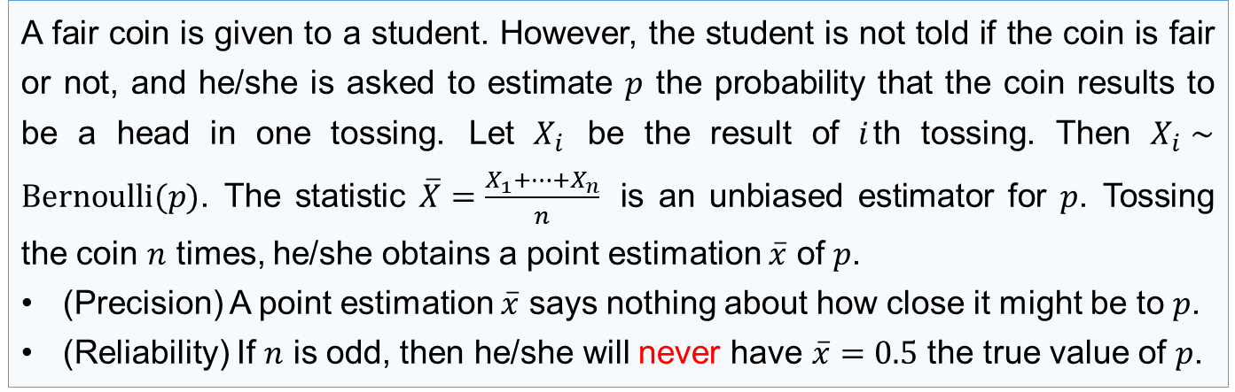
Introduction
A point estimation (点估计), because it is a single number, by itself provides no information about the precision and reliability of estimation.
Example (Tossing a coin)
A fair coin is given to a student. However, the student is not told if the coin is fair or not, and he/she is asked to estimate $p$ the probability that the coin results to be a head in one tossing. Let $X_{i}$ be the result of $i$th tossing. Then $X_{i}∼Bernoulli(p)$. The statistic $\overline{X}=\frac{X_{1}+⋯+X_{n}}{n}$ is an unbiased estimator for $p$. Tossing the coin $n$ times, he/she obtains a point estimation $\overline{x}$ of $p$.
(Precision) A point estimation $\overline{x}$ says nothing about how close it might be to $p$.
(Reliability) If $n$ is odd, then he/she will never have $\overline{x}=0.5$ the true value of $p$.
An alternative is to calculate and report an entire interval of plausible values—an interval estimate (区间估计) or confidence interval (CI, 置信区间).

Slide 4
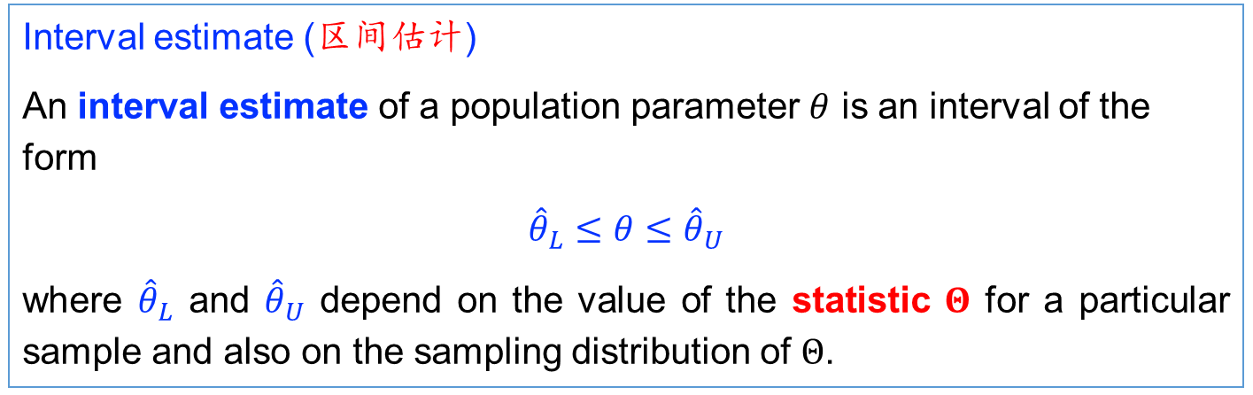
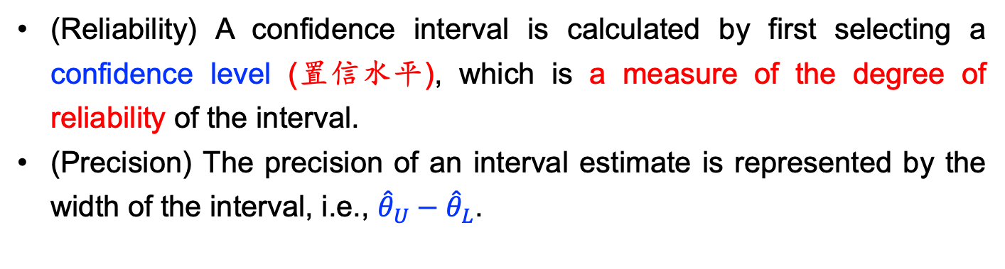
Interval estimate (区间估计)
An interval estimate of a population parameter $θ$ is an interval of the form
${\hat{θ}}_{L}≤θ≤{\hat{θ}}_{U}$
where ${\hat{θ}}_{L}$ and ${\hat{θ}}_{U}$ depend on the value of the statistic $Θ$ for a particular sample and also on the sampling distribution of $Θ$.
(Reliability) A confidence interval is calculated by first selecting a confidence level (置信水平), which is a measure of the degree of reliability of the interval.
(Precision) The precision of an interval estimate is represented by the width of the interval, i.e., ${\hat{θ}}_{U}−{\hat{θ}}_{L}$.

Slide 5
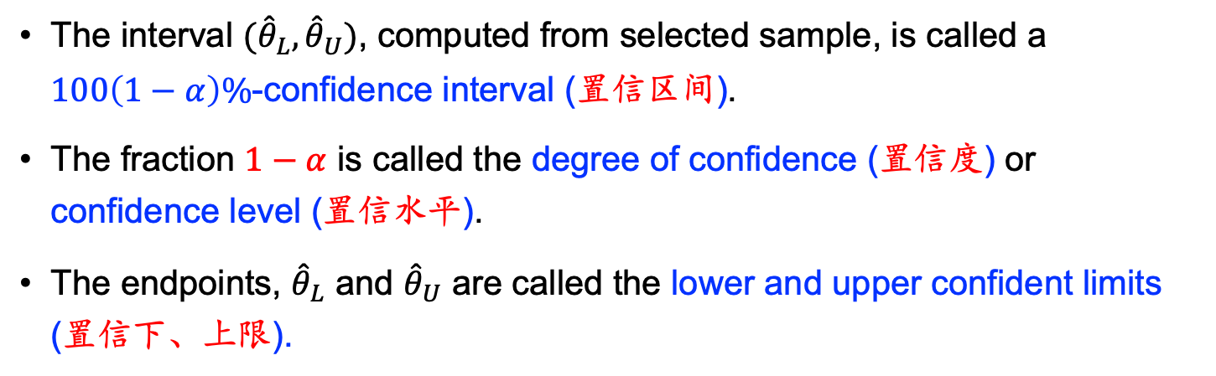
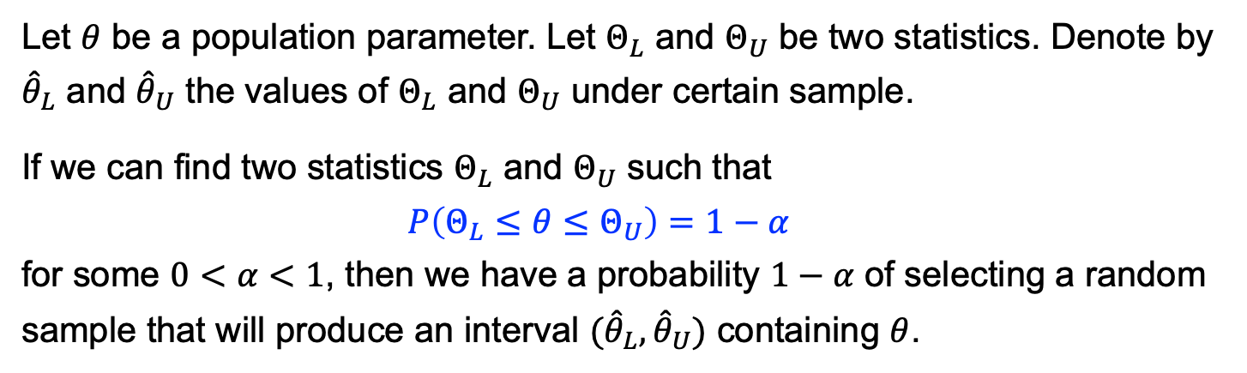
Interpretation of Interval Estimates
Let $θ$ be a population parameter. Let $Θ_{L}$ and $Θ_{U}$ be two statistics. Denote by ${\hat{θ}}_{L}$ and ${\hat{θ}}_{U}$ the values of $Θ_{L}$ and $Θ_{U}$ under certain sample.
If we can find two statistics $Θ_{L}$ and $Θ_{U}$ such that $P\left(Θ_{L}≤θ≤Θ_{U}\right)=1−α$ for some $0<α<1$, then we have a probability $1−α$ of selecting a random sample that will produce an interval ${(\hat{θ}}_{L}, {\hat{θ}}_{U})$ containing $θ$.
The interval ${(\hat{θ}}_{L}, {\hat{θ}}_{U})$, computed from selected sample, is called a $100\left(1−α\right)\%$-confidence interval (置信区间).
The fraction $1−α$ is called the degree of confidence (置信度) or confidence level (置信水平).
The endpoints, ${\hat{θ}}_{L}$ and ${\hat{θ}}_{U}$ are called the lower and upper confident limits (置信下、上限).

Slide 6
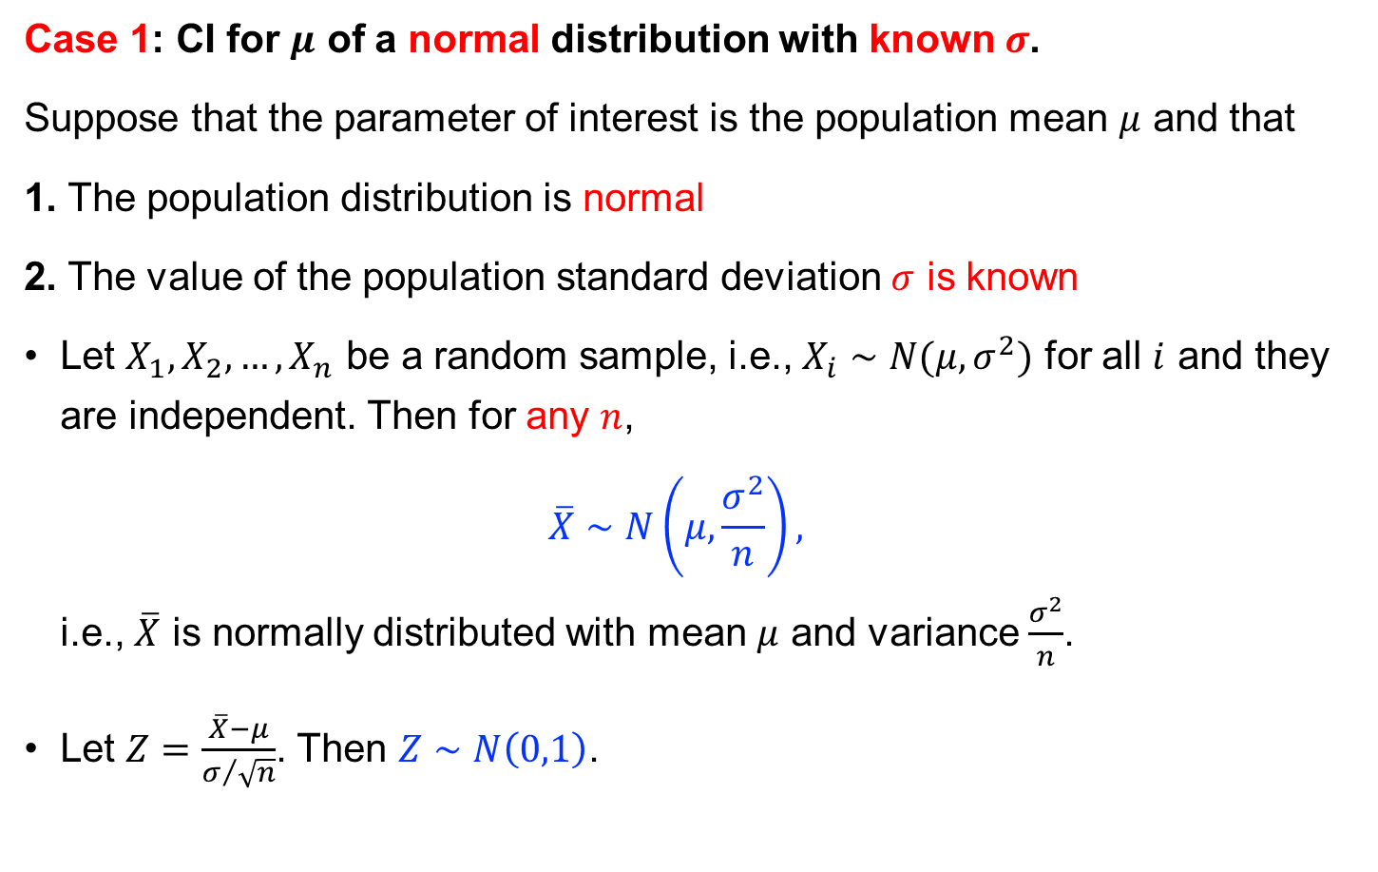
Estimating the Mean
Case 1: CI for $μ$ of a normal distribution with known $σ$.
Suppose that the parameter of interest is the population mean $μ$ and that
1. The population distribution is normal
2. The value of the population standard deviation $σ$ is known
Let $X_{1}, X_{2},…,X_{n}$ be a random sample, i.e., $X_{i}∼N(μ,σ^{2})$ for all $i$ and they are independent. Then for any $n$, $\overline{X}∼N\left(μ,\frac{σ^{2}}{n}\right),$ i.e., $\overline{X}$ is normally distributed with mean $μ$ and variance $\frac{σ^{2}}{n}$.
Let $Z=\frac{\overline{X}−μ}{σ/{\sqrt{n}}}$. Then $Z∼N\left(0,1\right)$.

Slide 7
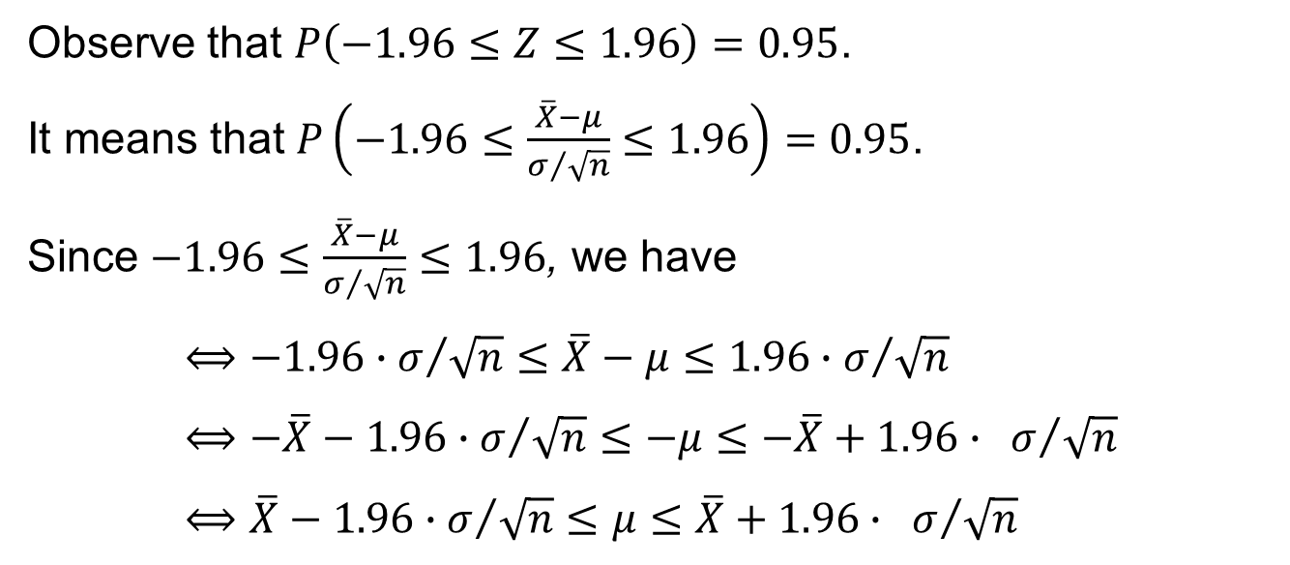
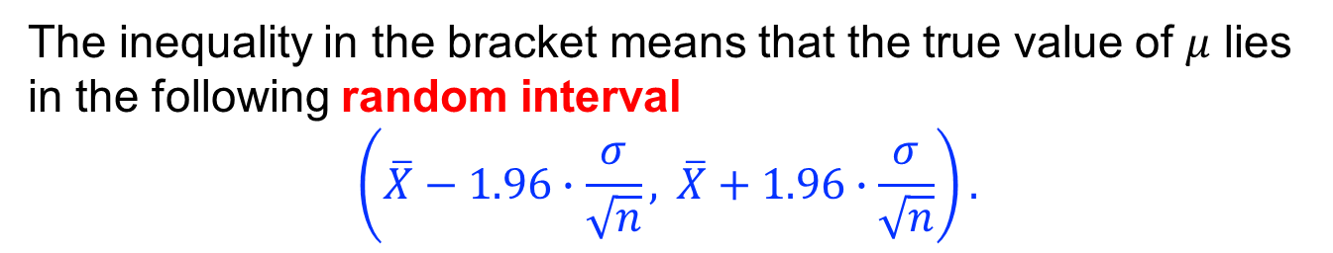
95% confidence interval
Observe that $P\left(−1.96≤Z≤1.96\right)=0.95$.
It means that $P\left(−1.96≤\frac{\overline{X}−μ}{σ/{\sqrt{n}}}≤1.96\right)=0.95$.
Since $−1.96≤\frac{\overline{X}−μ}{σ/{\sqrt{n}}}≤1.96$, we have $$⟺−1.96∙σ/{\sqrt{n}}≤\overline{X}−μ≤1.96∙σ/{\sqrt{n}} \\ ⟺−\overline{X}−1.96∙σ/{\sqrt{n}}≤−μ≤−\overline{X}+1.96∙ σ/{\sqrt{n}} \\ ⟺\overline{X}−1.96∙σ/{\sqrt{n}}≤μ≤\overline{X}+1.96∙ σ/{\sqrt{n}}$$
The inequality in the bracket means that the true value of $μ$ lies in the following random interval
$$\left(\overline{X}−1.96∙\frac{σ}{\sqrt{n}}, \overline{X}+1.96∙\frac{σ}{\sqrt{n}}\right).$$

Slide 8
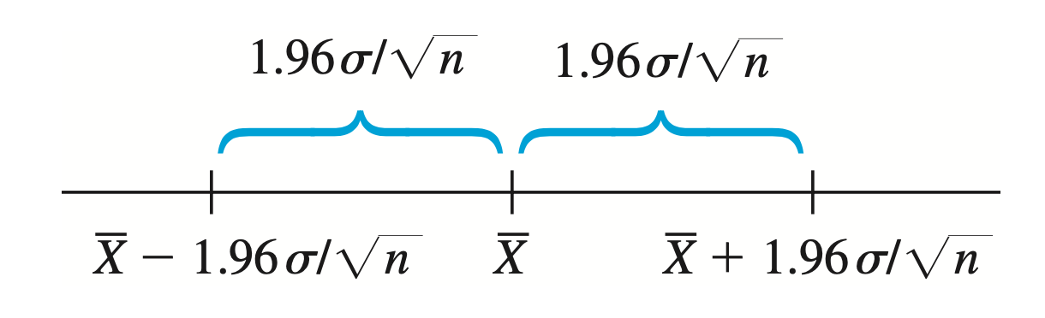
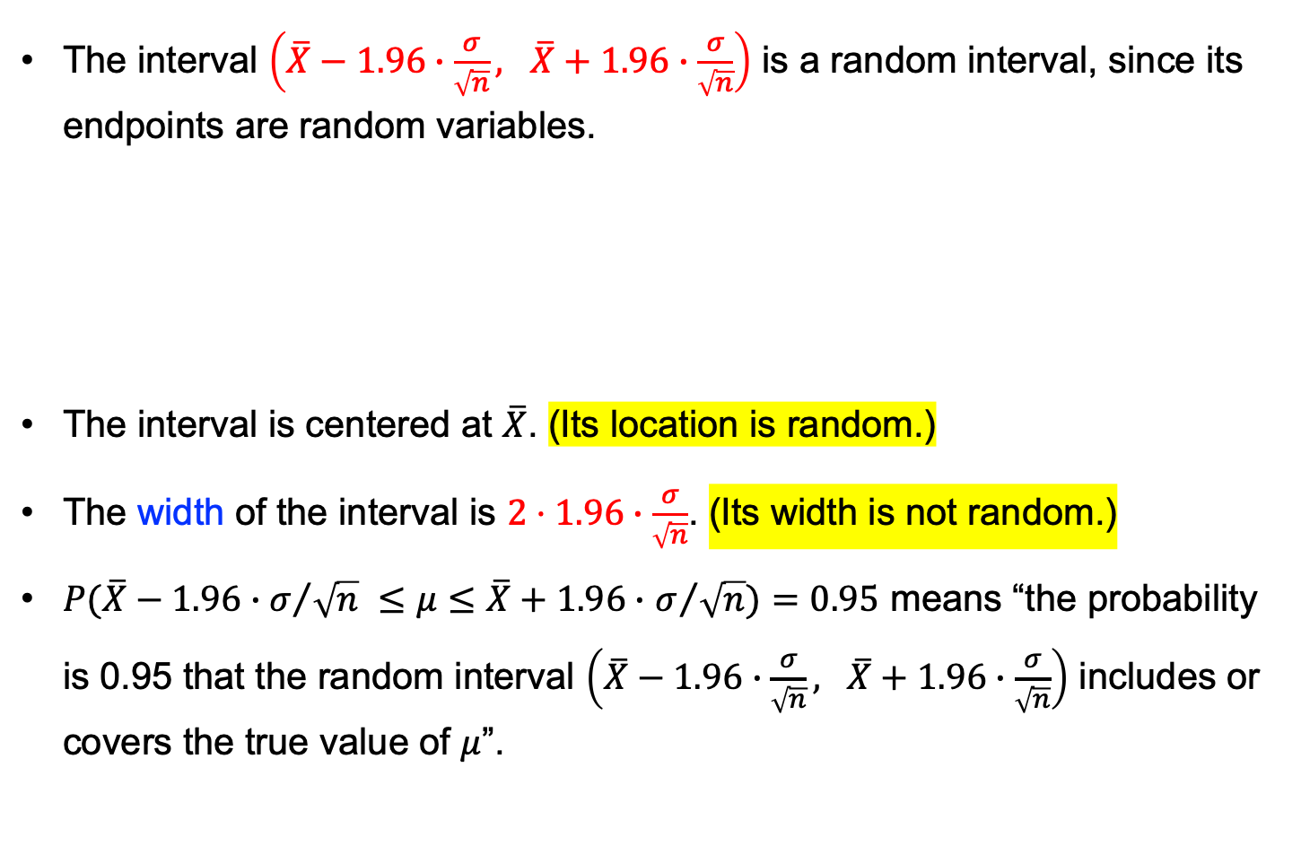
The interval $\left(\overline{X}−1.96∙\frac{σ}{\sqrt{n}}, \overline{X}+1.96∙\frac{σ}{\sqrt{n}}\right)$ is a random interval, since its endpoints are random variables.
The interval is centered at $\overline{X}$. (Its location is random.)
The width of the interval is $2⋅1.96∙\frac{σ}{\sqrt{n}}$. (Its width is not random.)
$P(\overline{X}−1.96∙σ/{\sqrt{n} }≤μ≤\overline{X}+1.96∙$ $σ/{\sqrt{n}})=0.95$ means “the probability is 0.95 that the random interval $\left(\overline{X}−1.96∙\frac{σ}{\sqrt{n}}, \overline{X}+1.96∙\frac{σ}{\sqrt{n}}\right)$ includes or covers the true value of $μ$”.

Slide 9
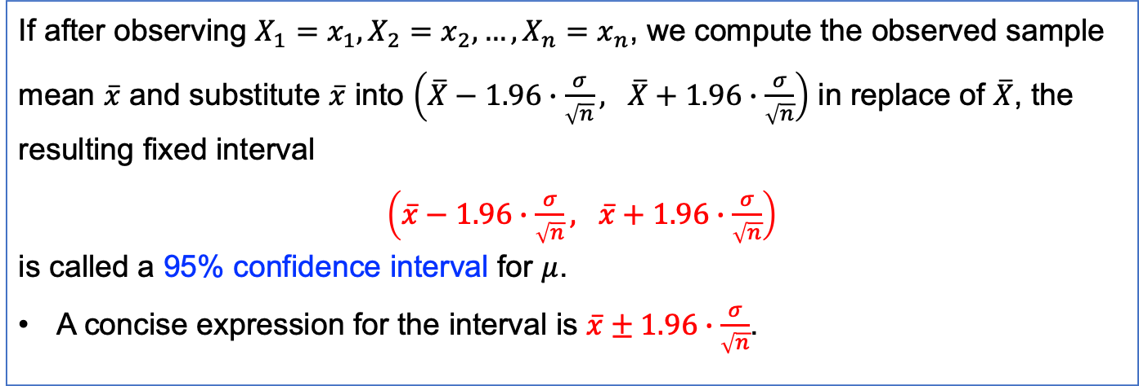
Definition (95% confidence interval)
If after observing $X_{1}=x_{1}, X_{2}=x_{2}, …, X_{n}=x_{n}$, we compute the observed sample mean $\overline{x}$ and substitute $\overline{x}$ into $\left(\overline{X}−1.96∙\frac{σ}{\sqrt{n}}, \overline{X}+1.96∙\frac{σ}{\sqrt{n}}\right)$ in replace of $\overline{X}$, the resulting fixed interval $\left(\overline{x}−1.96∙\frac{σ}{\sqrt{n}}, \overline{x}+1.96∙\frac{σ}{\sqrt{n}}\right)$ is called a 95% confidence interval for $μ$.
A concise expression for the interval is $\overline{x}±1.96∙\frac{σ}{\sqrt{n}}$.

Slide 10
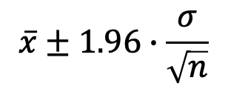
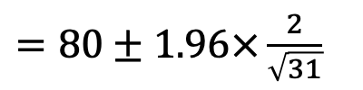

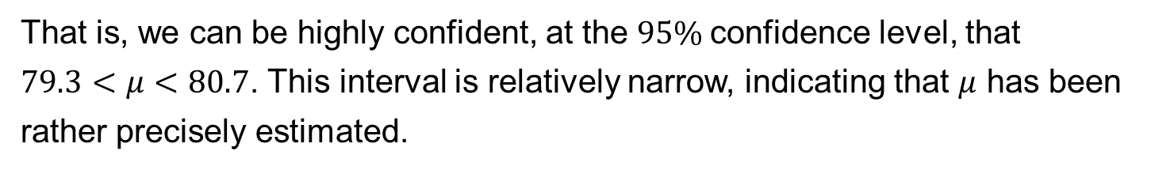
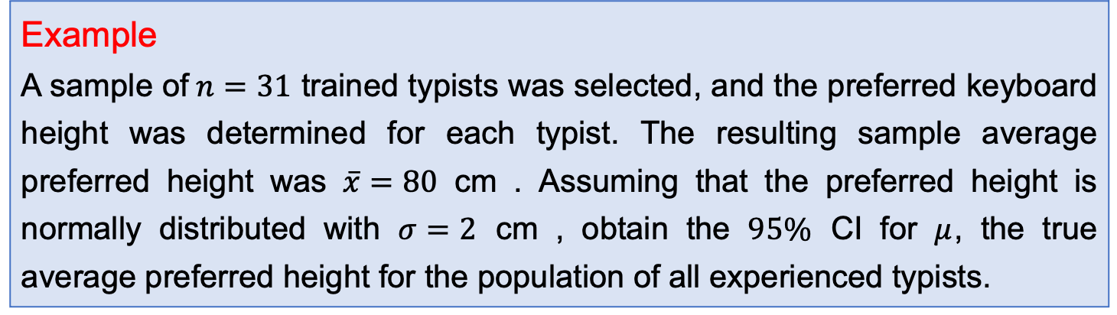
Example
A sample of$n=31$ trained typists was selected, and the preferred keyboard height was determined for each typist. The resulting sample average preferred height was $\overline{x}=80$ cm . Assuming that the preferred height is normally distributed with $σ=2$ cm , obtain the $95\%$ CI for $μ$, the true average preferred height for the population of all experienced typists.
Solution The resulting interval is
$$\overline{x}±1.96∙\frac{σ}{\sqrt{n}}$$
$=80±1.96×\frac{2}{\sqrt{31}}$
$$=80±0.7=(79.3, 80.7)$$
That is, we can be highly confident, at the $95\%$confidence level, that
$79.3<μ<80.7$. This interval is relatively narrow, indicating that $μ$ has been rather precisely estimated.
Is $P\left(79.3<μ<80.7\right)=0.95$?

Slide 11
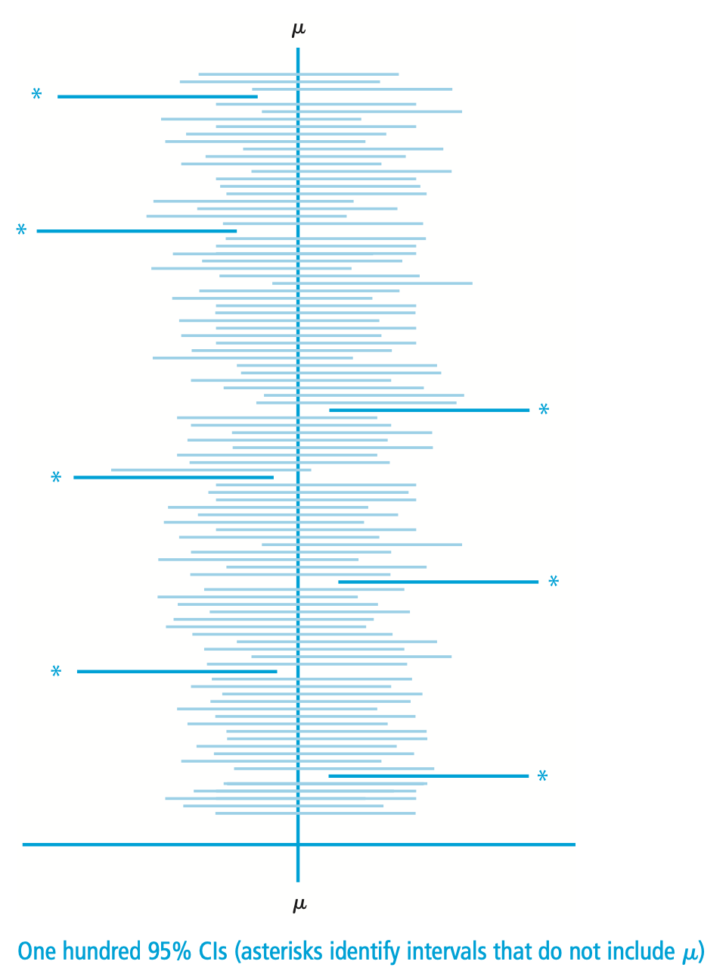
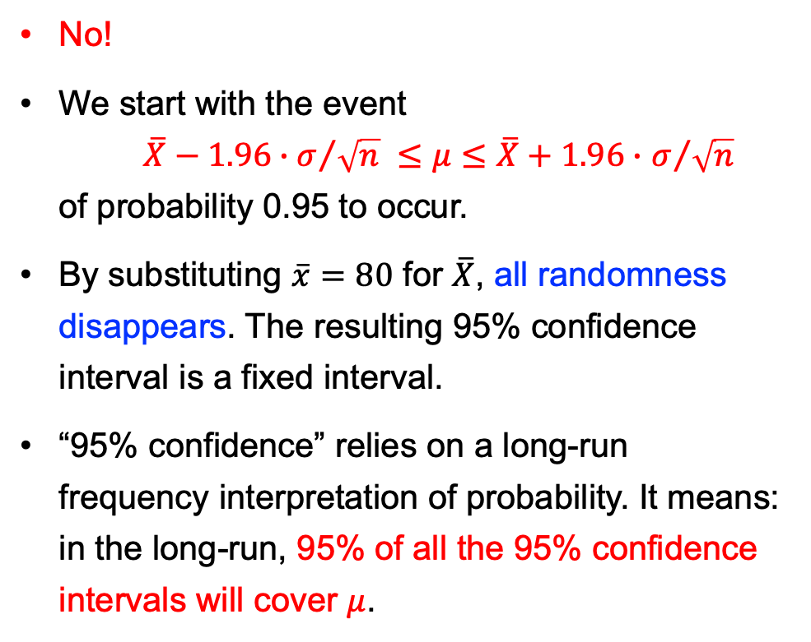
No!
We start with the event $\overline{X}−1.96∙σ/{\sqrt{n} }≤μ≤\overline{X}+1.96∙$ $σ/{\sqrt{n}}$ of probability 0.95 to occur.
By substituting $\overline{x}=80$ for $\overline{X}$, all randomness disappears. The resulting 95% confidence interval is a fixed interval.
“95% confidence” relies on a long-run frequency interpretation of probability. It means: in the long-run, 95% of all the 95% confidence intervals will cover $μ$.

Slide 12
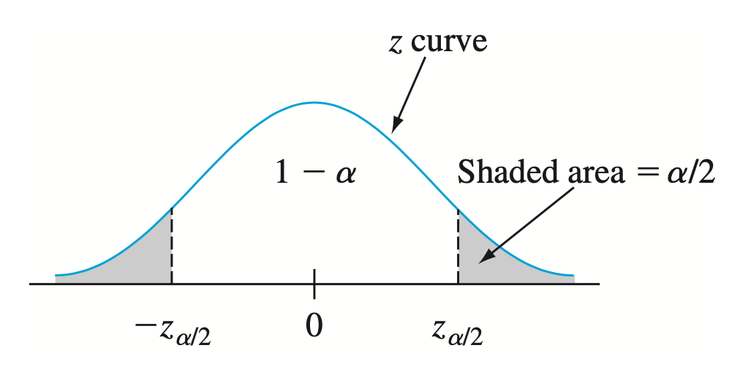
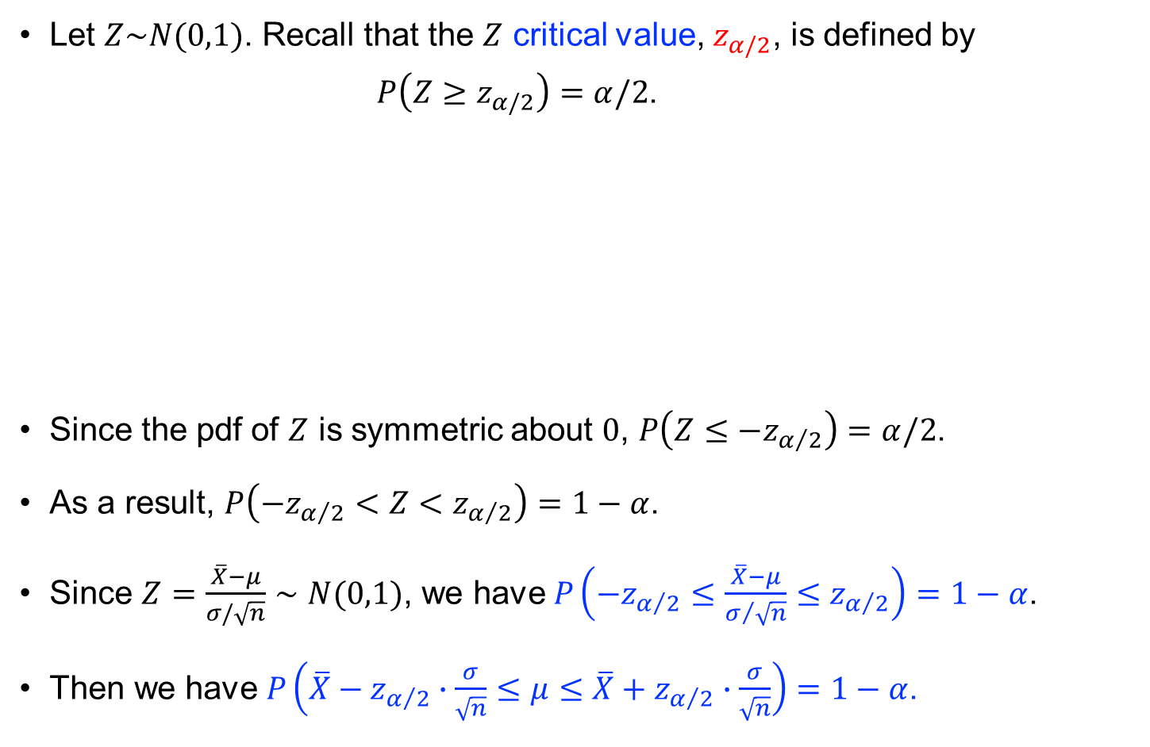
Other levels of confidence
Let $Z\sim N(0,1)$. Recall that the $Z$ critical value, $z_{α/2}$, is defined by $P\left(Z≥z_{α/2}\right)=α/2$.
Since the pdf of $Z$ is symmetric about $0$, $P\left(Z≤−z_{α/2}\right)=α/2$.
As a result, $P\left(−z_{α/2}<Z<z_{α/2}\right)=1−α$.
Since $Z=\frac{\overline{X}−μ}{σ/\sqrt{n}}∼N(0,1)$, we have $P\left(−z_{α/2}≤\frac{\overline{X}−μ}{σ/{\sqrt{n}}}≤z_{α/2}\right)=1−α$.
Then we have $P\left(\overline{X}−z_{α/2}∙\frac{σ}{\sqrt{n}}≤μ≤\overline{X}+z_{α/2}∙\frac{σ}{\sqrt{n}}\right)=1−α$.

Slide 13
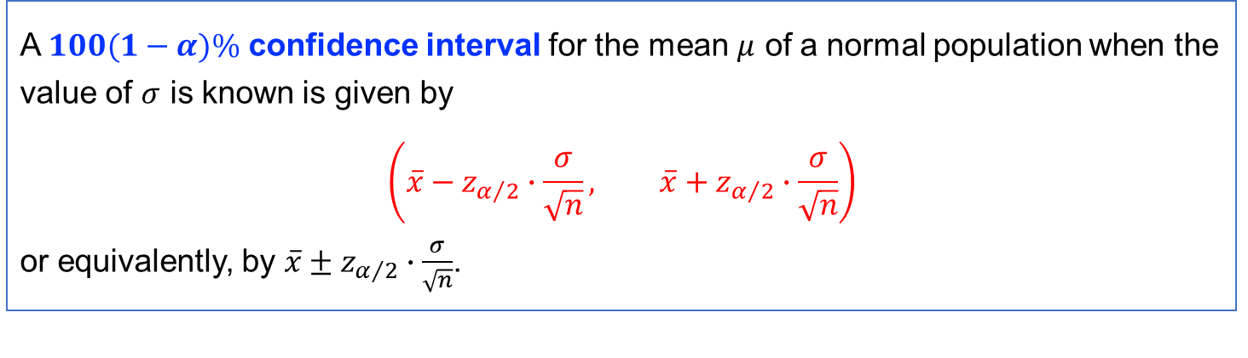
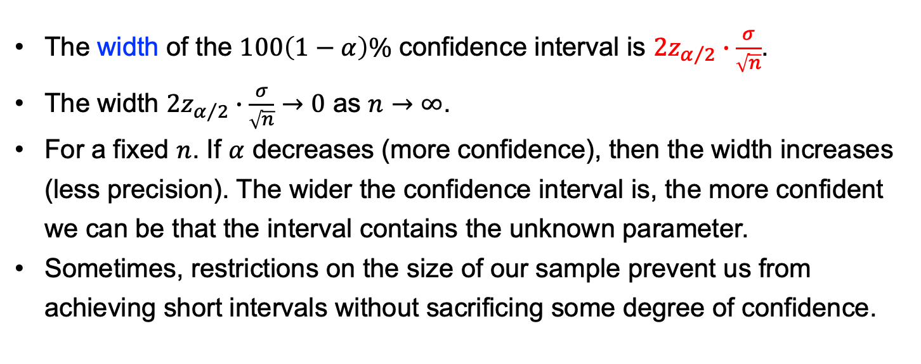
Definition
A $100(1−α)\%$ confidence interval for the mean $μ$ of a normal population when the value of $σ$ is known is given by $$\left(\overline{x}−z_{α/2}∙\frac{σ}{\sqrt{n}}, \overline{x}+z_{α/2}∙\frac{σ}{\sqrt{n}}\right)$$ or equivalently, by $\overline{x}±z_{α/2}∙\frac{σ}{\sqrt{n}}$.
The width of the $100\left(1−α\right)\%$ confidence interval is $2z_{α/2}∙\frac{σ}{\sqrt{n}}$.
The width $2z_{α/2}∙\frac{σ}{\sqrt{n}}→0$ as $n→∞$.
For a fixed $n$. If $α$ decreases (more confidence), then the width increases (less precision). The wider the confidence interval is, the more confident we can be that the interval contains the unknown parameter.
Sometimes, restrictions on the size of our sample prevent us from achieving short intervals without sacrificing some degree of confidence.

Slide 14
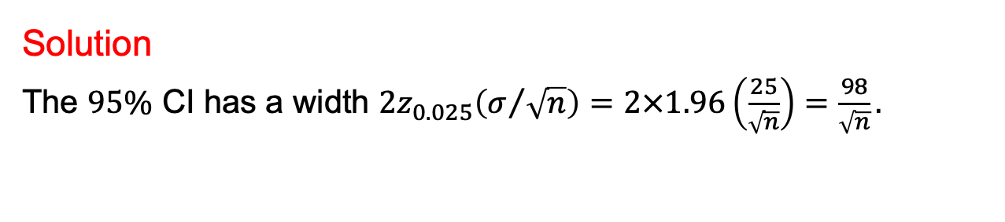

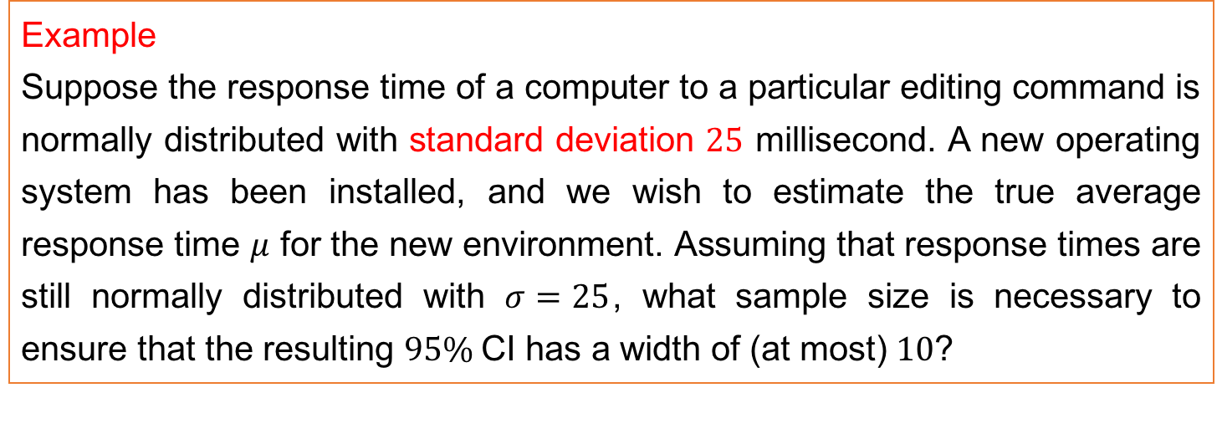
Example
Suppose the response time of a computer to a particular editing command is normally distributed with standard deviation $25$ millisecond. A new operating system has been installed, and we wish to estimate the true average response time $μ$ for the new environment. Assuming that response times are still normally distributed with $σ=25$, what sample size is necessary to ensure that the resulting $95\%$CI has a width of (at most) $10$?
Solution
The $95\%$ CI has a width $2z_{0.025}\left(σ/{\sqrt{n}}\right)=2×1.96\left(\frac{25}{\sqrt{n}}\right)=\frac{98}{\sqrt{n}}.$
Solve $\frac{98}{\sqrt{n}}≤10$ to obtain $n≥{9.8}^{2}=96.04$.
Since $n$ must be an integer, a sample size of $97$ is required.
In general, to ensure an interval width $w$, the necessary sample size $n$ should be $n={\left(2z_{α/2}⋅\frac{σ}{w}\right)}^{2}$ .

Slide 15
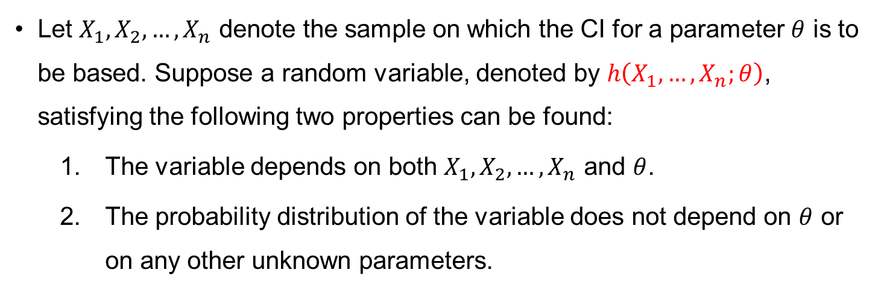
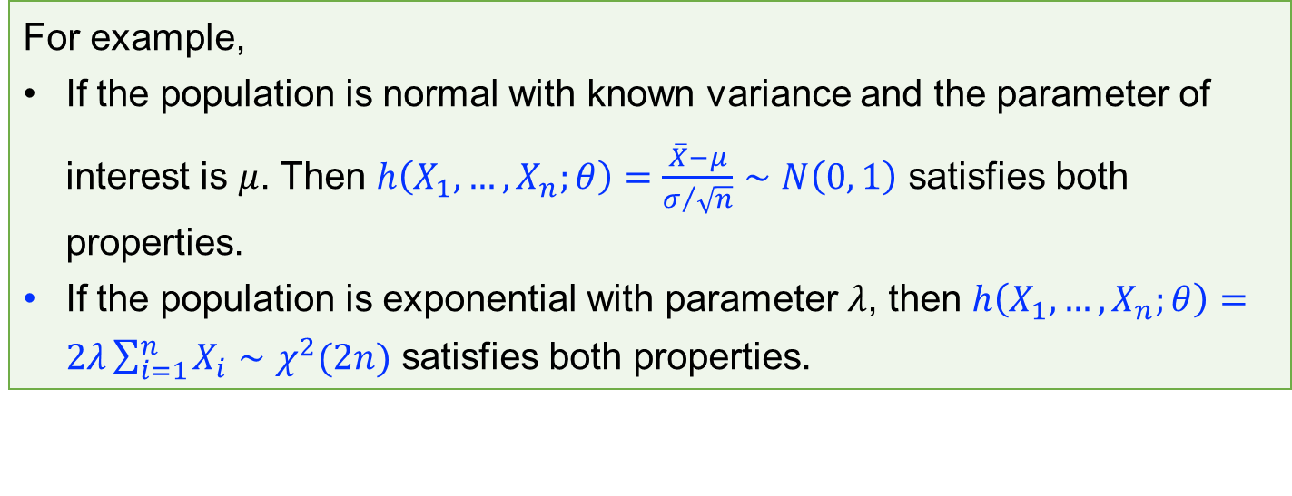
Deriving a confidence interval
Let $X_{1}, X_{2},…,X_{n}$ denote the sample on which the CI for a parameter $θ$ is to be based. Suppose a random variable, denoted by $h\left(X_{1},…,X_{n};θ\right)$, satisfying the following two properties can be found:
The variable depends on both $X_{1}, X_{2},…,X_{n}$ and $θ$.
The probability distribution of the variable does not depend on $θ$ or on any other unknown parameters.
For example,
If the population is normal with known variance and the parameter of interest is $μ$. Then $h\left(X_{1},…,X_{n};θ\right)=\frac{\overline{X}−μ}{σ/{\sqrt{n}}}∼N\left(0, 1\right)$ satisfies both properties.
If the population is exponential with parameter $λ$, then $h\left(X_{1},…,X_{n};θ\right)=2λ\sum_{i=1}^{n}{X_{i}}∼χ^{2}(2n)$ satisfies both properties.

Slide 16
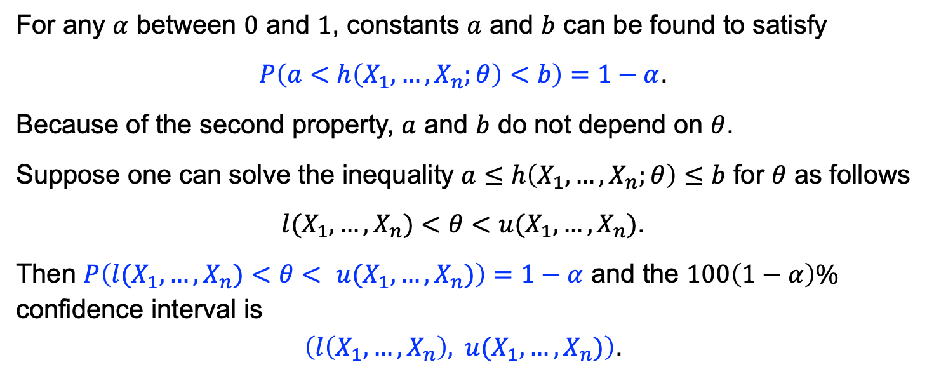
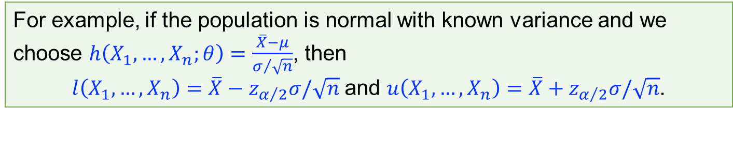
For any $α$ between $0$ and $1$, constants $a$ and $b$ can be found to satisfy
$P\left(a<h\left(X_{1},…,X_{n};θ\right)<b\right)=1−α$.
Because of the second property, $a$ and $b$ do not depend on $θ$.
Suppose one can solve the inequality $a≤h\left(X_{1},…,X_{n};θ\right)≤b$ for $θ$ as follows
$l(X_{1},…,X_{n})<θ<$ $u(X_{1},…,X_{n})$.
Then $P\left(l(X_{1},…,X_{n})<θ< u(X_{1},…,X_{n})\right)=1−α$ and the $100\left(1−α\right)\%$ confidence interval is
$\left(l\left(X_{1},…,X_{n}\right), u(X_{1},…,X_{n})\right)$.
For example, if the population is normal with known variance and we choose $h\left(X_{1},…,X_{n};θ\right)=\frac{\overline{X}−μ}{σ/{\sqrt{n}}}$, then
$l\left(X_{1},…,X_{n}\right)=\overline{X}−z_{α/2}σ/\sqrt{n}$ and $u\left(X_{1},…,X_{n}\right)=\overline{X}+z_{α/2}σ/\sqrt{n}$.

Slide 17
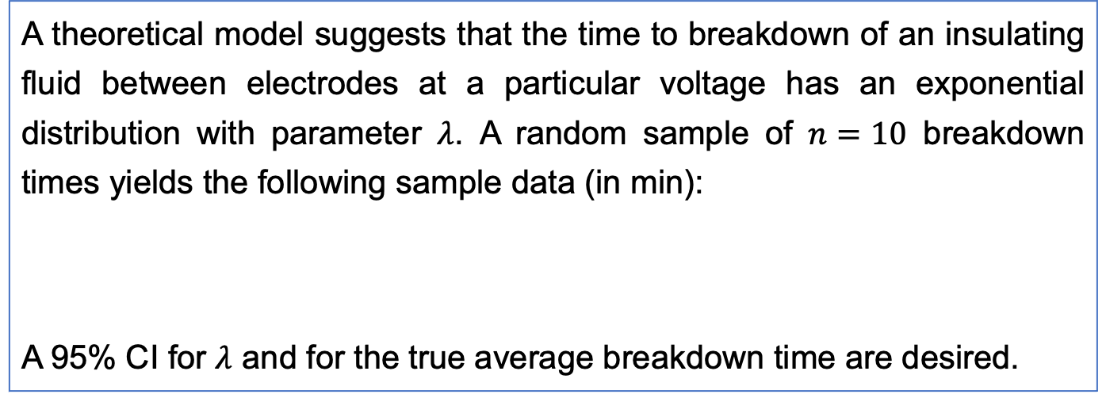
Example
A theoretical model suggests that the time to breakdown of an insulating fluid between electrodes at a particular voltage has an exponential distribution with parameter $λ$. A random sample of $n=10$ breakdown times yields the following sample data (in min):
A 95% CI for $λ$ and for the true average breakdown time are desired.
$$x_{1}$$ | $$x_{2}$$ | $$x_{3}$$ | $$x_{4}$$ | $$x_{5}$$ | $$x_{6}$$ | $$x_{7}$$ | $$x_{8}$$ | $$x_{9}$$ | $$x_{10}$$
41.53 | 18.73 | 2.99 | 30.34 | 12.33 | 117.52 | 73.02 | 223.63 | 4.00 | 26.78

Slide 18
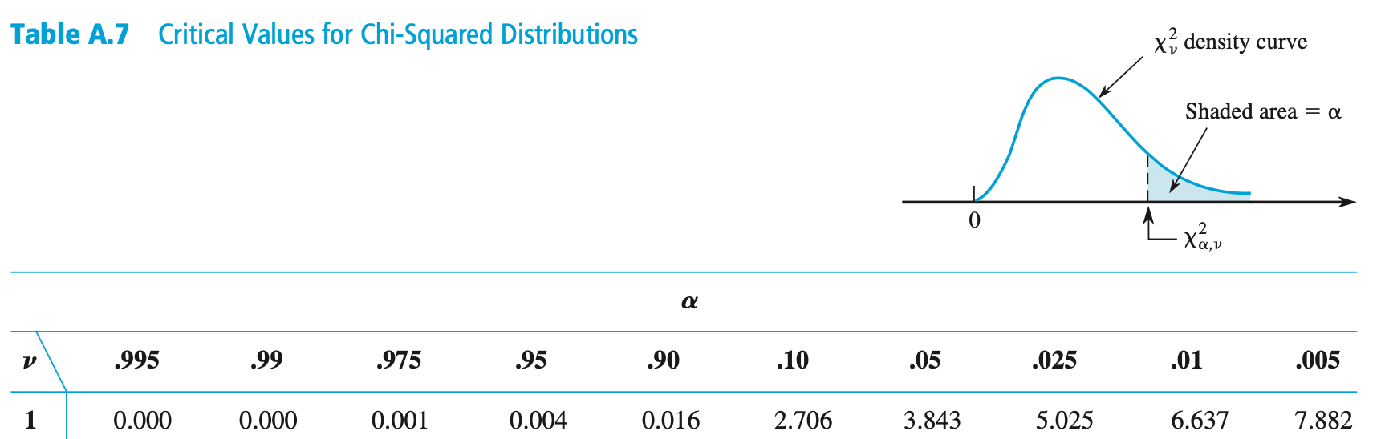
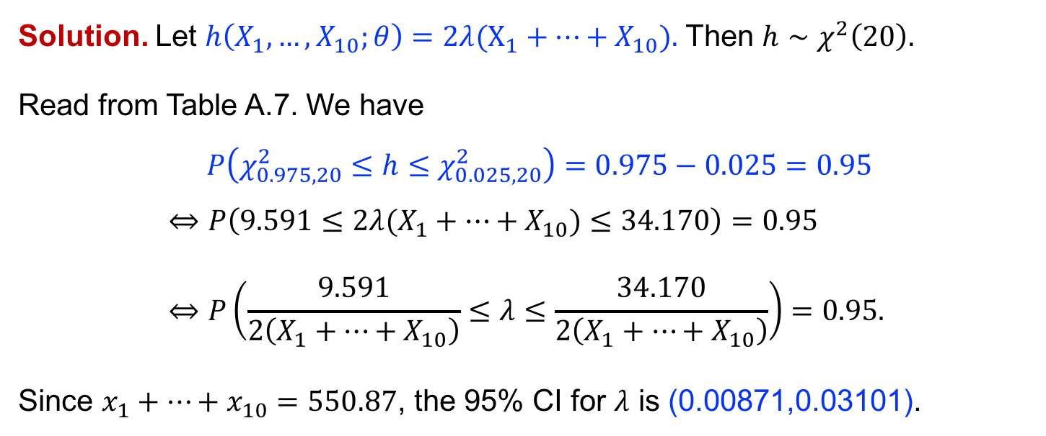
Solution. Let $h\left(X_{1},…,X_{10};θ\right)=2λ(X_{1}+…+X_{10}).$ Then $h∼χ^{2}\left(20\right).$
Read from Table A.7. We have
$$P\left(χ_{0.975,20}^{2}≤h≤χ_{0.025,20}^{2}\right)=0.975−0.025=0.95$$
$$⇔P\left(9.591≤2λ(X_{1}+…+X_{10})≤34.170\right)=0.95 \\ ⇔P\left(\frac{9.591}{2\left(X_{1}+…+X_{10}\right)}≤λ≤\frac{34.170}{2\left(X_{1}+…+X_{10}\right)}\right)=0.95.$$
Since $x_{1}+…+x_{10}=550.87$, the 95% CI for $λ$ is (0.00871,0.03101).

Slide 19

Recall that if $X∼\text{Exponential}(λ)$, then $E\left(X\right)=\frac{1}{λ}.$ From the above, we have
$$P\left(\frac{2\left(X_{1}+…+X_{10}\right)}{34.170}≤\frac{1}{λ}≤\frac{2\left(X_{1}+…+X_{10}\right)}{9.591}\right)=0.95.$$
The 95% CI for the true average breakdown time is (32.24,114.87).

Slide 20
7.2 Large-sample confidence intervals for a population mean and proportion

Slide 21
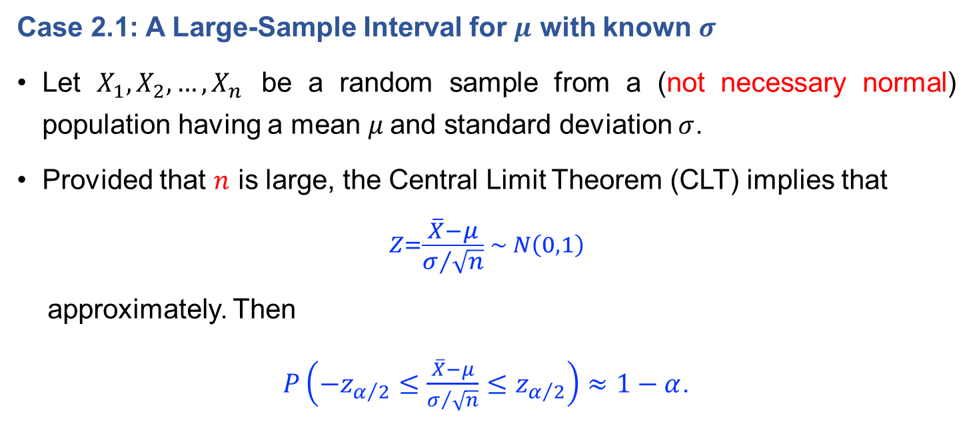
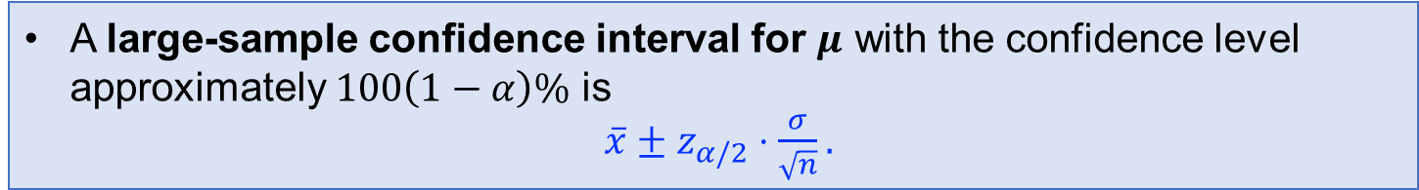

A large-sample interval for $μ$
Case 2.1: A Large-Sample Interval for $μ$ with known $σ$
Let $X_{1}, X_{2},…,X_{n}$ be a random sample from a (not necessary normal) population having a mean $μ$and standard deviation $σ$.
Provided that $n$ is large, the Central Limit Theorem (CLT) implies that
$$Z=\frac{\overline{X}−μ}{σ/{\sqrt{n}}} ∼ N\left(0,1\right)$$
approximately. Then
$P\left(−z_{α/2}≤\frac{\overline{X}−μ}{σ/{\sqrt{n}}}≤z_{α/2}\right)≈1−α$.
A large-sample confidence interval for $μ$ with the confidence level approximately $100\left(1−α\right)\%$ is
$\overline{x}±z_{α/2}⋅\frac{σ}{\sqrt{n}}.$

Slide 22
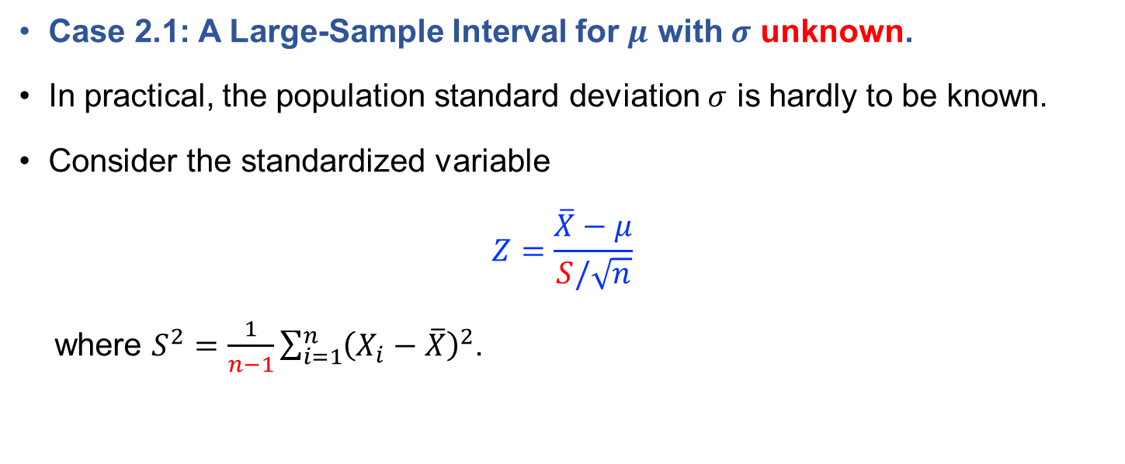
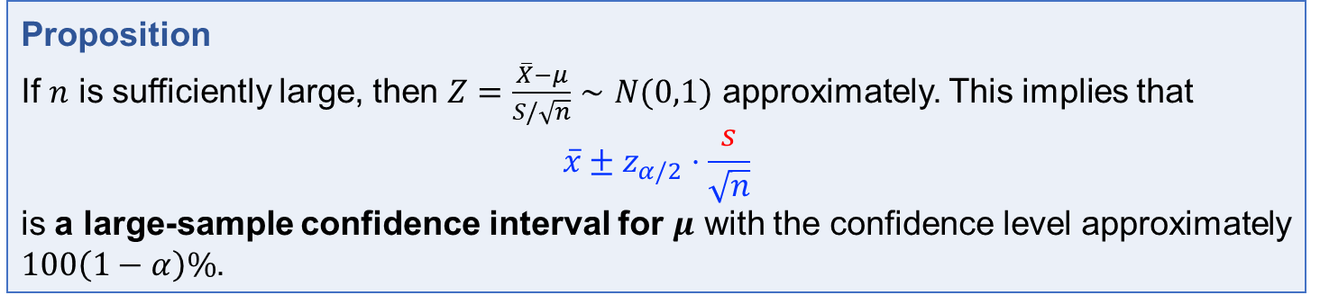
Case 2.1: A Large-Sample Interval for $μ$ with $σ$ unknown.
In practical, the population standard deviation $σ$ is hardly to be known.
Consider the standardized variable
$$Z=\frac{\overline{X}−μ}{S/\sqrt{n}}$$
where $S^{2}=\frac{1}{n−1}\sum_{i=1}^{n}{{\left(X_{i}−\overline{X}\right)}^{2}}$.
Proposition
If $n$ is sufficiently large, then $Z=\frac{\overline{X}−μ}{S/\sqrt{n}}∼N(0,1)$ approximately. This implies that
$$\overline{x}±z_{α/2}⋅\frac{s}{\sqrt{n}}$$
is a large-sample confidence interval for $μ$ with the confidence level approximately $100\left(1−α\right)\%$.

Slide 23
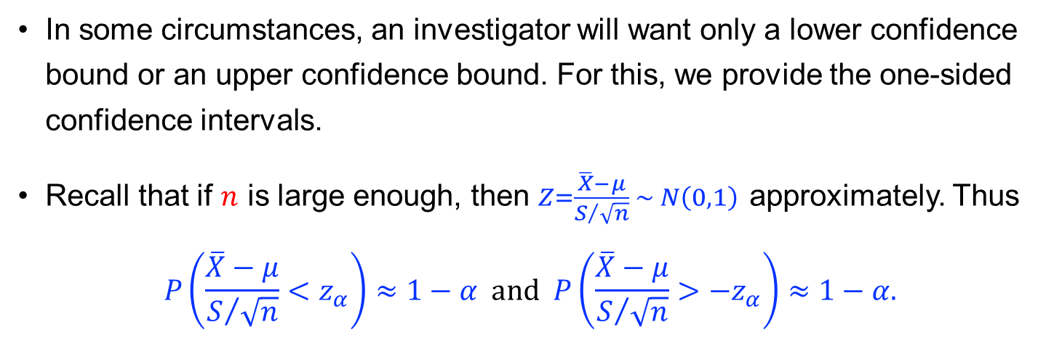
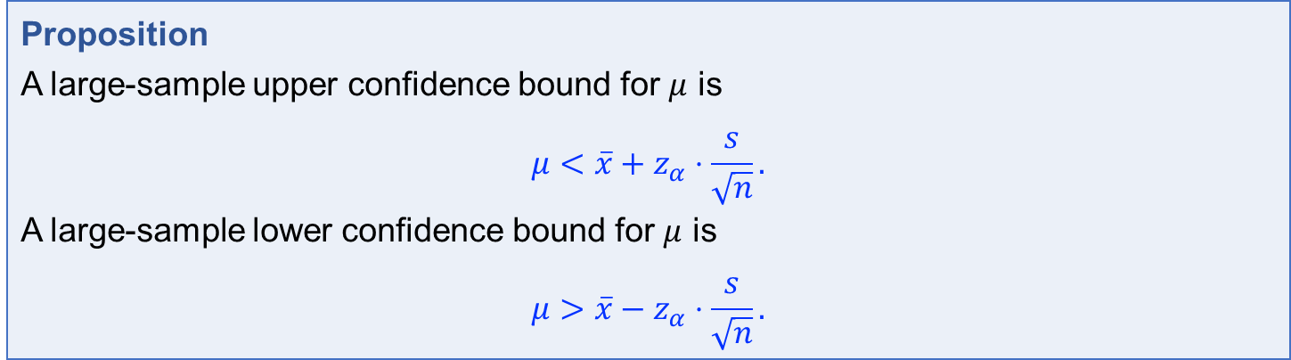
One-sided confidence intervals
In some circumstances, an investigator will want only a lower confidence bound or an upper confidence bound. For this, we provide the one-sided confidence intervals.
Recall that if $n$ is large enough, then $Z=\frac{\overline{X}−μ}{S/{\sqrt{n}}} ∼ N\left(0,1\right)$ approximately. Thus
$$P\left(\frac{\overline{X}−μ}{S/{\sqrt{n}}}<z_{α}\right)≈1−α \text{and} P\left(\frac{\overline{X}−μ}{S/{\sqrt{n}}}>{−z}_{α}\right)≈1−α.$$
Proposition
A large-sample upper confidence bound for $μ$ is
$$μ<\overline{x}+z_{α}⋅\frac{s}{\sqrt{n}}.$$
A large-sample lower confidence bound for $μ$ is
$$μ>\overline{x}−z_{α}⋅\frac{s}{\sqrt{n}}.$$

Slide 24

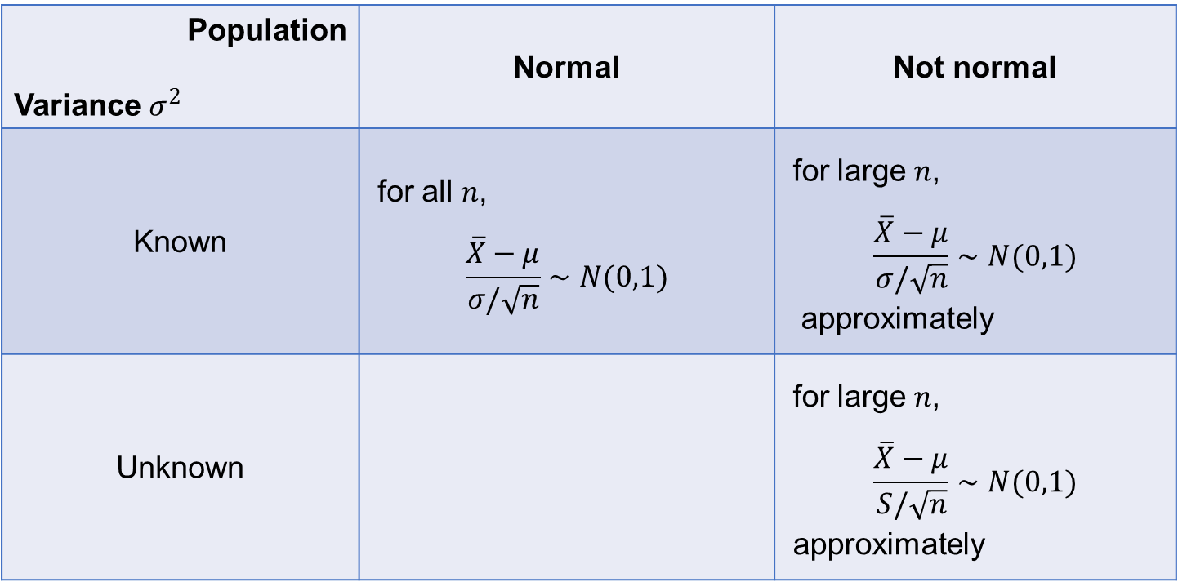
Remark
Let $X_{1}, X_{2},…,X_{n}$ be a random sample from a population with mean $μ$and standard deviation $σ$. Denote by $\overline{X}$ and $S^{2}$ its sample mean and sample variance.
Population Variance $σ^{2}$ | Normal | Not normal
Known | for all $n$, $$\frac{\overline{X}−μ}{σ/\sqrt{n}}∼N(0,1)$$ | for large $n$, $$\frac{\overline{X}−μ}{σ/\sqrt{n}}∼N(0,1)$$ approximately
Unknown |  | for large $n$, $$\frac{\overline{X}−μ}{S/\sqrt{n}}∼N(0,1)$$ approximately
?
for all $n$,
$$\frac{\overline{X}−μ}{S/\sqrt{n}}∼t(n−1)$$

Slide 25
7.3 Intervals based on a normal population distribution

Slide 26
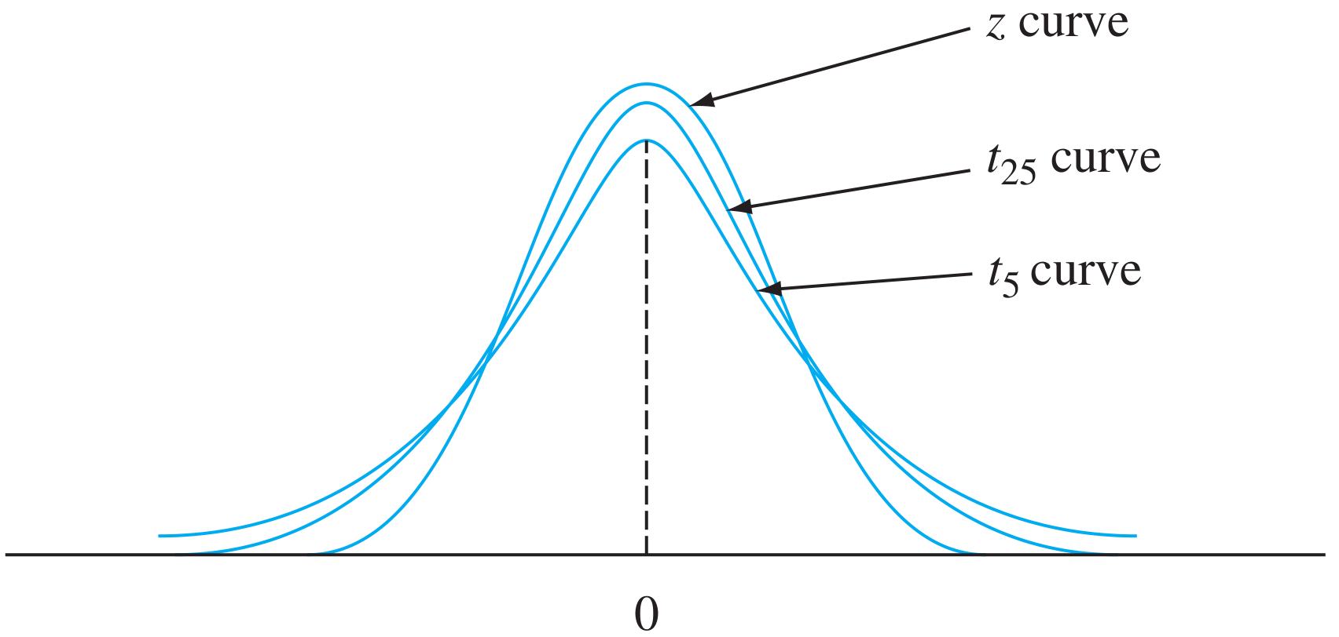
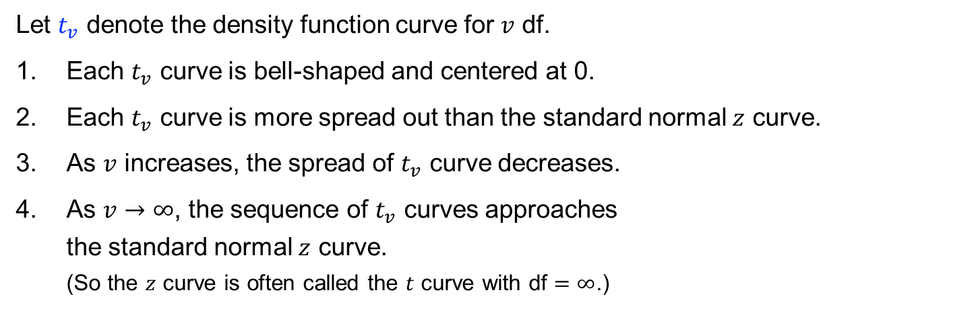
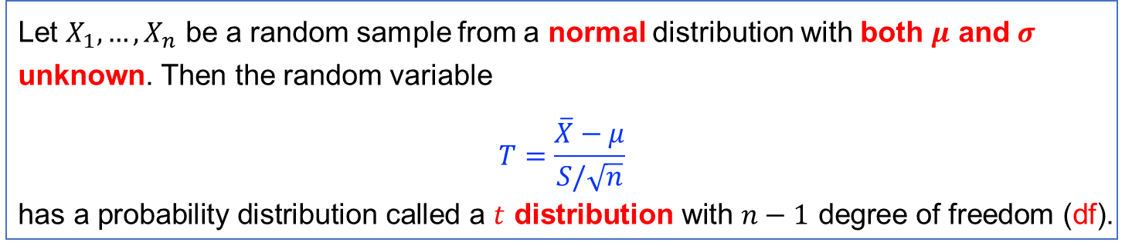
Properties of $t$ distributions
Theorem
Let $X_{1},…,X_{n}$ be a random sample from a normal distribution with both $μ$ and $σ$ unknown. Then the random variable
$$T=\frac{\overline{X}−μ}{S/\sqrt{n}}$$
has a probability distribution called a $t$ distribution with $n−1$ degree of freedom (df).
Let $t_{v}$ denote the density function curve for $v$ df.
Each $t_{v}$ curve is bell-shaped and centered at 0.
Each $t_{v}$ curve is more spread out than the standard normal $z$ curve.
As $v$ increases, the spread of $t_{v}$ curve decreases.
As $v→∞$, the sequence of $t_{v}$ curves approaches the standard normal $z$ curve. (So the $z$ curve is often called the $t$ curve with df $=∞$.)

Slide 27
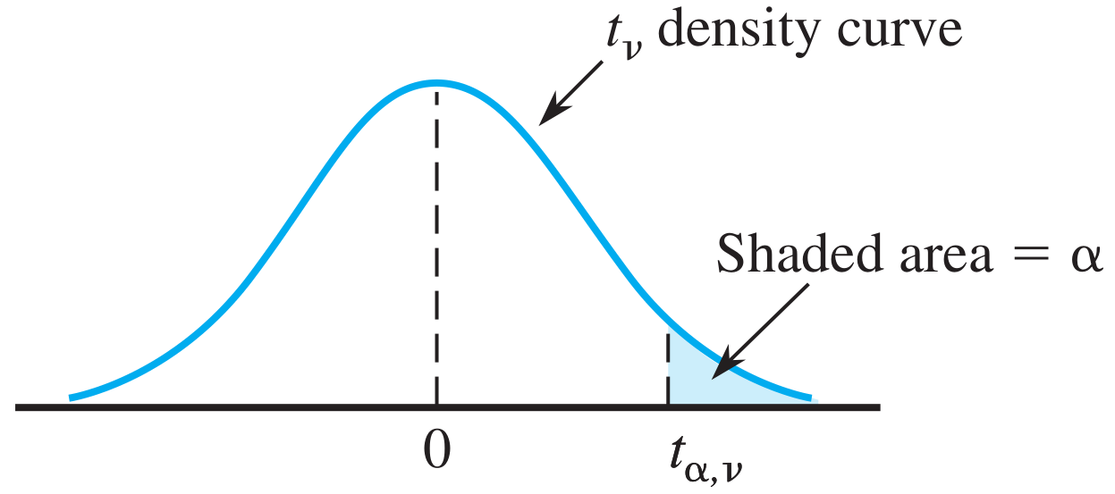
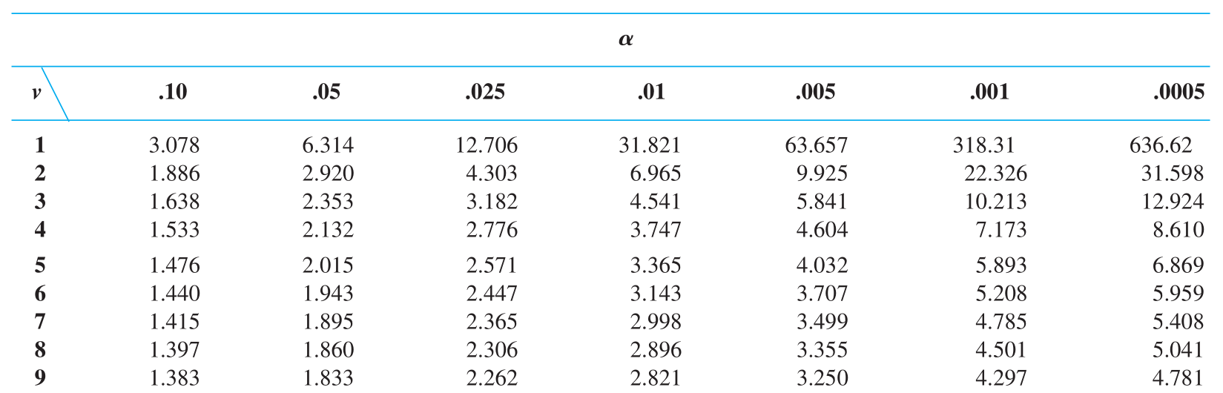
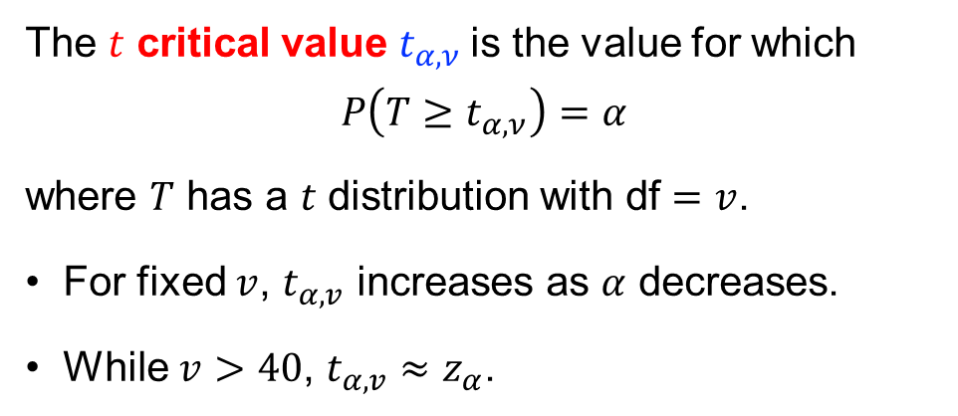
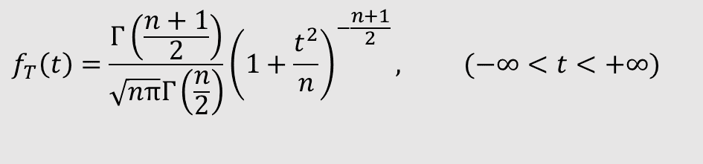
The $t$ critical value $t_{α,ν}$is the value for which
$$P\left(T≥t_{α,ν}\right)=α$$
where $T$ has a $t$ distribution with df $=v$.
For fixed $v$, $t_{α,v}$ increases as $α$ decreases.
While $v>40$, $t_{α,v}≈z_{α}$.
$$f_{T}\left(t\right)=\frac{Γ\left(\frac{n+1}{2}\right)}{\sqrt{nπ}Γ\left(\frac{n}{2}\right)}{\left(1+\frac{t^{2}}{n}\right)}^{−\frac{n+1}{2}}, (−∞<t<+∞)$$

Slide 28

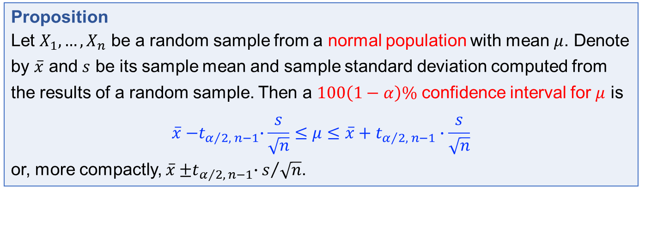
The one-sample 𝑡 confidence interval
Recall that $T=\frac{\overline{X}−μ}{S/{\sqrt{n}}}$ has $t$ distribution with $n−1$ df. Then
$$P\left({−t}_{α/2, n−1}<T<t_{α/2, n−1}\right)=1−α.$$
Solving the inequality for $μ$, one has
$$P\left(\overline{X}{−t}_{α/2, n−1}∙\frac{S}{\sqrt{n}}≤μ≤\overline{X}+t_{α/2, n−1}∙\frac{S}{\sqrt{n}}\right)=1−α.$$
Proposition
Let $X_{1},…,X_{n}$ be a random sample from a normal population with mean $μ$. Denote by $\overline{x}$ and $s$ be its sample mean and sample standard deviation computed from the results of a random sample. Then a $100\left(1−α\right)\%$ confidence interval for $μ$ is
$$\overline{x}{−t}_{α/2, n−1}∙\frac{s}{\sqrt{n}}≤μ≤\overline{x}+t_{α/2, n−1}∙\frac{s}{\sqrt{n}}$$
or, more compactly, $\overline{x}{±t}_{α/2, n−1}∙s/{\sqrt{n}}$.

Slide 29

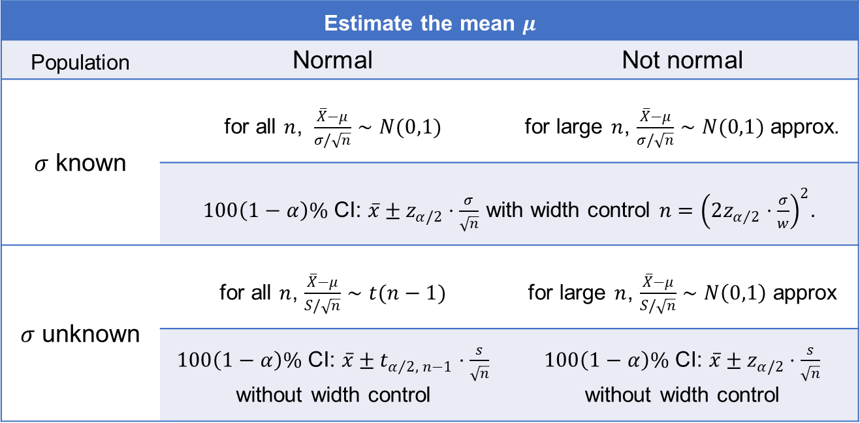
It is not easy to select $n$ to control the width of the $t$ interval, since the width involves unknown (before the data is collected) $s$ and $t_{α/2, n−1}$.
Estimate the mean $μ$
Population | Normal | Not normal
$σ$ known | for all $n$, $\frac{\overline{X}−μ}{σ/\sqrt{n}}∼N(0,1)$ | for large $n$, $\frac{\overline{X}−μ}{σ/\sqrt{n}}∼N(0,1)$ approx.
 | $100\left(1−α\right)\%$ CI: $\overline{x}±z_{α/2}⋅\frac{σ}{\sqrt{n}}$ with width control $n={\left(2z_{α/2}⋅\frac{σ}{w}\right)}^{2}$.
$σ$ unknown | for all $n$, $\frac{\overline{X}−μ}{S/\sqrt{n}}∼t(n−1)$ | for large $n$, $\frac{\overline{X}−μ}{S/\sqrt{n}}∼N\left(0,1\right)$ approx
 | $100\left(1−α\right)\%$ CI: $\overline{x}±t_{α/2, n−1}⋅\frac{s}{\sqrt{n}}$ without width control | $100\left(1−α\right)\%$ CI: $\overline{x}±z_{α/2}⋅\frac{s}{\sqrt{n}}$ without width control

Slide 30

Example
Consider the following observations on modulus of elasticity (Mpa) obtained 1 minute after loading in a certain configuration:
Assume that the population distribution is normal. Find a two-sided 95% confidence interval for the population mean modulus of elasticity.
10,490 | 16,620 | 17,300 | 15,480 | 12,970 | 17,260 | 13,400 | 13,900
13,630 | 13,260 | 14,370 | 11,700 | 15,470 | 17,840 | 14,070 | 14,760
Solution.
The sample size $n=16$, so a confidence interval for population mean modulus of elasticity is based on $15$ df. One find that $\overline{x}=14532.5$ and $s=2055.67$.
A confidence level of 95% for a two-sided interval requires the t critical value $t_{0.025, 15}=2.131$. The resulting interval is
$$\overline{x}±t_{0.025, 15}⋅\frac{s}{\sqrt{n}}=14532.5±\left(2.131\right)⋅\frac{2055.67}{\sqrt{16}} \\ =14532.5±1095.2 \\ =\left(13437.3,15627.7\right).$$

Slide 31



Prediction interval
Example
Consider the following sample of fat content (in percentage) of $n=10$ randomly selected hot dogs:
25.2 21.3 22.8 17.0 29.8 21.0 25.5 16.0 20.9 19.5
Assuming that these were selected from a normal population distribution, find a 95% CI for the population mean fat content.
Solution.
The population is normal and its variance is unknown.
The sample mean $\overline{x}=21.90$ and the sample standard deviation $s=4.134$.
The 95% CI is
$$\overline{x}±t_{0.025, 9}⋅\frac{s}{\sqrt{n}}=21.90±2.262⋅\frac{4.134}{\sqrt{10}}=21.90±2.96=\left(18.94, 24.86\right).$$
If you are going to eat a single hot dog of this type, then it is reasonable to predict the resulting fat content is around $\overline{x}=21.90$.
However, this prediction gives no information about reliability or precision.

Slide 32

Let $X_{1},…,X_{n}$ be a (available) random sample from a normal population.
We wish to predict the value of $X_{n+1}$, a single future observation.
Recall that $E\left(\overline{X}\right)=E(X_{n+1})$. Then $\overline{X}$ will be a point predictor for $X_{n+1}$.
Since $X_{i}∼N\left(μ,σ^{2}\right)$ for all $i$ and they are independent, we have
$$\text{Var}\left(\overline{X}−X_{n+1}\right)=\text{Var}\left(\overline{X}\right)+\text{Var}\left(X_{n+1}\right)=\frac{σ^{2}}{n}+σ^{2}=σ^{2}\left(1+\frac{1}{n}\right)$$
and$\overline{X}−X_{n+1}∼N\left(0, σ^{2}\left(1+\frac{1}{n}\right)\right)$.
When $σ$ is known, one has
$$Z=\frac{\overline{X}−X_{n+1}}{\sqrt{σ^{2}\left(1+\frac{1}{n}\right)}}∼N\left(0, 1\right).$$
When $σ$ is unknown, one has
$$T=\frac{\overline{X}−X_{n+1}}{\sqrt{S^{2}\left(1+\frac{1}{n}\right)}}∼t \text{distribution} \text{with} n−1 \text{df}\text{.}$$

Slide 33


Proposition
A prediction interval (PI) with prediction level $100\left(1−α\right)\%$ for a single observation to be selected from a normal population distribution is
when $σ$ is known, $\overline{x}±z_{α/2}⋅σ\sqrt{1+\frac{1}{n}};$
When $σ$ is unknown, $\overline{x}±t_{α/2, n−1}⋅s\sqrt{1+\frac{1}{n}}$.
Example （continued）
Consider the following sample of fat content (in percentage) of $n=10$ randomly selected hot dogs:
25.2 21.3 22.8 17.0 29.8 21.0 25.5 16.0 20.9 19.5
Assuming that these were selected from a normal population distribution, a 95% PI for the fat content of a single hot dog is
$$\overline{x}±t_{α/2, n−1}⋅s\sqrt{1+\frac{1}{n}}=21.90±\left(2.262\right)\left(4.134\right)\sqrt{1+\frac{1}{10}} \\ =21.90±9.81=\left(12.09, 31.71\right).$$

Slide 34
7.4 CI for the variance and standard deviation of a normal population

Slide 35




CI for the variance of a normal distribution
Let $X$ be a chi-squared random variable with df $=v$, i.e., $X∼χ^{2}\left(v\right)$. Let $f(x;v)$ be the pdf of $X$. Then
$$f\left(x;v\right)=\left\{\begin{matrix}\frac{1}{2^{v/2}Γ(v/2)}x^{v/2−1}e^{−x/2}, & x>0, \\ 0, & x≤0.\end{matrix}\right.$$
The chi-squared critical value, denoted by $χ_{α, v}^{2}$, is the number satisfying
$$P\left(\frac{\left(n−1\right)S^{2}}{σ^{2}}>χ_{α, v}^{2}\right)=α.$$

Slide 36



Case 1: $μ$ is known
Proposition
Let $X_{1},…,X_{n}$ be a random sample from a normal population with mean $μ$ and variance $σ^{2}$. Then for $i=1,…,n$,
$$\frac{X_{i}−μ}{σ}∼N\left(0, 1\right) \text{and} {（\frac{X_{i}−μ}{σ}）}^{2}∼χ^{2}\left(1\right).$$
Further,
$$\frac{\sum_{i=0}^{n}{{\left(X_{i}−μ\right)}^{2}}}{σ^{2}}∼χ^{2}\left(n\right).$$
It follows from the above that
$$P\left(χ_{1−α/2, n}^{2}<\frac{\sum_{i=0}^{n}{{\left(X_{i}−μ\right)}^{2}}}{σ^{2}}<χ_{α/2, n}^{2}\right)=1−α.$$
Solving the inequalities for $σ^{2}$, one has
$$P\left(\frac{\sum_{i=0}^{n}{{\left(X_{i}−μ\right)}^{2}}}{χ_{α/2, n}^{2}}<σ^{2}<\frac{\sum_{i=0}^{n}{{\left(X_{i}−μ\right)}^{2}}}{χ_{1−α/2, n}^{2}}\right)=1−α.$$
($μ$ known) A $100\left(1−α\right)\%$ confidence interval for $σ^{2}$ of a normal population is
$\left(\frac{\sum_{i=0}^{n}{{\left(X_{i}−μ\right)}^{2}}}{χ_{α/2, n}^{2}}, \frac{\sum_{i=0}^{n}{{\left(X_{i}−μ\right)}^{2}}}{χ_{1−α/2, n}^{2}}\right)$.

Slide 37



Case 2: $μ$ is unknown
Theorem
Let $X_{1},…,X_{n}$ be a random sample from a normal population with mean $μ$ and variance $σ^{2}$. Then the random variable
$$\frac{\left(n−1\right)S^{2}}{σ^{2}}=\frac{∑{\left(X_{i}−\overline{X}\right)}^{2}}{σ^{2}}∼χ^{2}\left(n−1\right).$$
Recall that $\frac{\left(n−1\right)S^{2}}{σ^{2}}∼χ^{2}\left(n−1\right).$ As a consequence,
$$P\left(χ_{1−\frac{α}{2}, n−1}^{2}<\frac{\left(n−1\right)S^{2}}{σ^{2}}<χ_{\frac{α}{2}, n−1}^{2}\right)=1−α.$$
Solving the inequalities for $σ^{2}$, one has
$$P\left(\frac{\left(n−1\right)S^{2}}{χ_{\frac{α}{2}, n−1}^{2}}<σ^{2}<\frac{\left(n−1\right)S^{2}}{χ_{1−\frac{α}{2}, n−1}^{2}}\right)=1−α.$$
($μ$ unknown) A $100\left(1−α\right)\%$ confidence interval for $σ^{2}$ of a normal population is
$\left(\frac{\left(n−1\right)S^{2}}{χ_{\frac{α}{2}, n−1}^{2}}, \frac{\left(n−1\right)S^{2}}{χ_{1−\frac{α}{2}, n−1}^{2}}\right)$.

Slide 38



Example
Suppose the following sample were selected from a normal population distribution.
Please find a $95\%$CI for the population variance $σ^{2}$.
1470 | 1510 | 1690 | 1740 | 1900 | 2000 | 2030 | 2100 | 2190
2200 | 2290 | 2380 | 2390 | 2480 | 2500 | 2580 | 2700
$$\left(\frac{\left(n−1\right)S^{2}}{χ_{\frac{α}{2}, n−1}^{2}}, \frac{\left(n−1\right)S^{2}}{χ_{1−\frac{α}{2}, n−1}^{2}}\right)$$
Solution.
The sample size is $n=17.$ The population mean $μ$ is unknown.
The computed value of the sample variance is $s^{2}=137324.3$.
With df$=17−1=16$, a $95\%$CI requires
$χ_{0.975, 16}^{2}=6.908$ and $χ_{0.025, 16}^{2}=28.845$.
The desired CI is $\left(\frac{16\left(137324.3\right)}{28.845},\frac{16\left(137324.3\right)}{6.908}\right)=\left(76172.3, 318064.4\right).$

Slide 39
The end.

